Slide 1
VOICE CONTROLLER DESKTOP ASSISTANCE
BY:
DEEPA SRI VADLA [ 23911A0514 ]
GUIDE:
DR.ZAHEER AHMED

Slide 2
ABSTRACT
Jarvis is a Python-based voice assistant developed to make human–computer interaction easier and more natural. It allows users to perform basic tasks using voice commands instead of manual input. The assistant listens to the user’s voice, converts speech into text, processes the command, and responds through voice output, providing a user-friendly experience.
The system is built using Python libraries such as Speech Recognition for voice input processing and pyttsx3 for text-to-speech conversion. Jarvis can perform tasks like searching information on Wikipedia, opening websites such as Google and YouTube, playing music, and telling the current time. This project helps in understanding speech processing and automation concepts and demonstrates how Python can be used to build simple and effective voice-based applications.

Slide 3
INTRODUCTION
Voice assistants are widely used in modern technology as they enable hands-free interaction with computers and digital systems.
By allowing users to give commands through voice, human–computer interaction becomes simpler, faster, and more convenient.
This project focuses on developing a simple desktop voice assistant using Python that can understand voice commands and perform basic tasks, making everyday computer usage easier and more user-friendly.

Slide 4

OBJECTIVE
To design and develop a voice-controlled assistant using Python
To understand speech-to-text and text-to-speech technologies
To automate basic desktop operations
To provide a user-friendly and beginner-level voice assistant

Slide 5
EXISTING SYSTEM
Users interact with systems using keyboard and mouse
Manual searching and navigation is time-consuming
No voice-based automation in basic desktop systems
Existing assistants are complex and require high resources

Slide 6
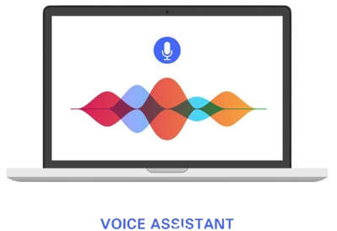
PROPOSED SYSTEM
A simple Python-based voice assistant
Accepts voice input through microphone
Converts speech into text and processes commands
Executes tasks automatically and responds using voice
Lightweight, cost-effective, and easy to use

Slide 7
LITERATURE REVIEW
Voice assistants use speech recognition and natural language processing
Previous systems like Siri and Alexa are cloud-based and complex
Python provides libraries for easy speech processing
Research shows voice-based systems improve accessibility and efficiency

Slide 8
SOFTWARE AND HARDWARE REQUIREMENTS
Software Requirements Operating System: Windows Programming Language: Python Libraries: pyttsx3 , Speech Recognition, Wikipedia IDE: VS Code | Hardware Requirements Computer or Laptop Microphone or Headset Internet connection (for speech recognition)

Slide 9
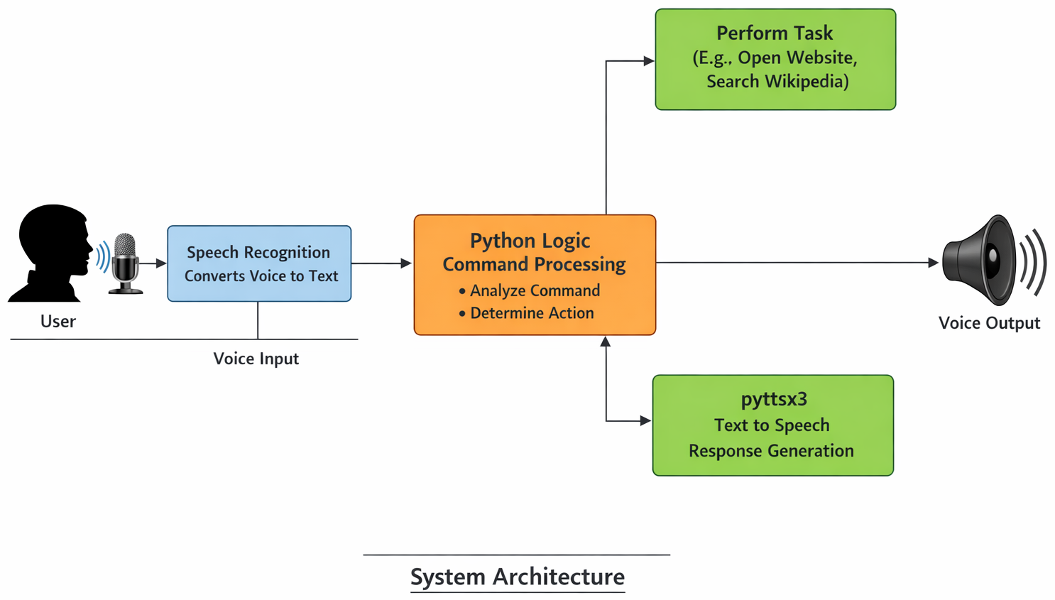
ARCHITECTURE

Slide 10
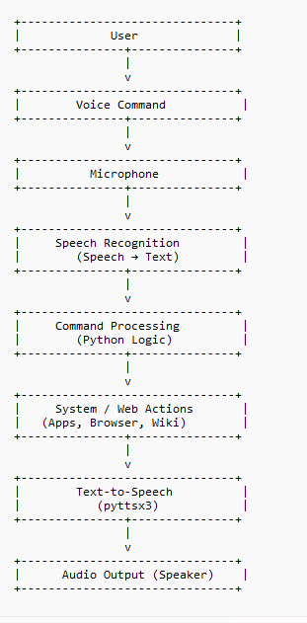
ARCHITECTURE
User gives voice input
Microphone captures audio
Speech Recognition converts audio
to text
Python logic processes the command
Required action is performed
pyttsx3 converts response text into
speech

Slide 11
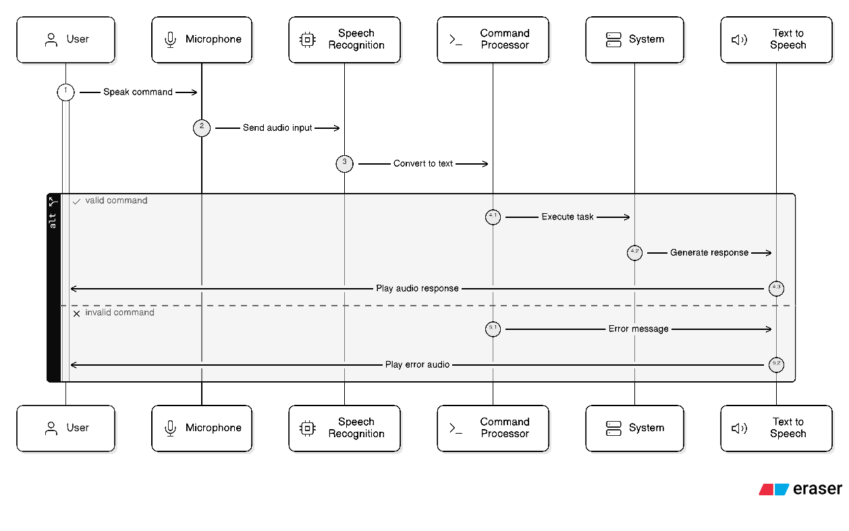
ARCHITECTURE
SEQUENCE DIAGRAM

Slide 12
ACTIVITY DIAGRAM
Start
↓
User gives voice input
↓
Convert speech to text
↓
Is command recognized?
↓ Yes ↓ No
Process command Ask to repeat
↓
Execute action
↓
Convert to speech
↓
Output to user
↓
End

Slide 13
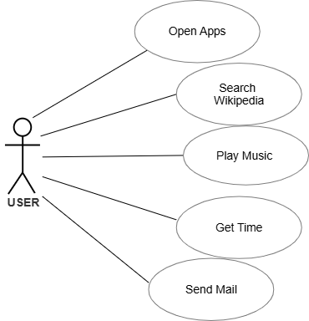
USE CASE DIAGRAM
.

Slide 14
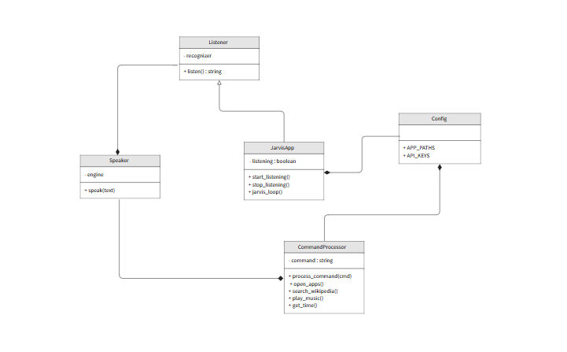
CLASS DIAGRAM

Slide 15
MODULES OVERVIEW
Module Description
The Jarvis system is divided into multiple functional modules
Each module performs a specific task in the system
Modular design improves flexibility and scalability
Main Modules:
Voice Input Module
Speech Recognition Module
Command Processing Module
Task Execution Module
Voice Output Module

Slide 16
MODULE EXPLANATION
Voice Input Module
Captures user voice through microphone
Speech Recognition Module
Converts speech into text using SpeechRecognition
Command Processing Module
Analyzes text and identifies user command
Task Execution Module
Performs actions (open apps, search, play music, etc.)
Voice Output Module
Converts response into speech using pyttsx3

Slide 17
WORKING & TECHNOLOGIES
Working Flow
User gives voice input
Speech → Text conversion
Command processing
Action execution
Response → Speech output
Technologies Used
Python
SpeechRecognition
pyttsx3
OS & Webbrowser modules

Slide 18



REFERENCES
Python Official Documentation
Speech Recognition Library
Documentation
pyttsx3 Documentation
Wikipedia API Documentation
Online tutorials and research articles

Slide 19
THANK YOU

